Slide 1
Logic Families
Designed by: Asadullah Jamalov
Logic family is a group of electronic logic gates constructed using one of several different designs. The list of logic families can be divided into categories:
Resistor–transistor logic (RTL)
Diode–resistor logic (DRL)
Complementary MOS (CMOS) logic
Emitter-coupled logic (ECL)
Transistor–transistor logic (TTL)
Bipolar MOS (BiMOS) logic
Bipolar CMOS (BiCMOS)
Diode–transistor logic (DTL)
Gunning transceiver logic (GTL)
Integrated injection logic (I2L)
And others.

Slide 2
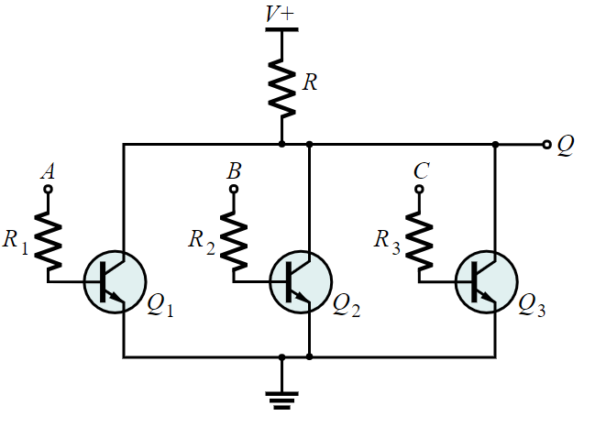
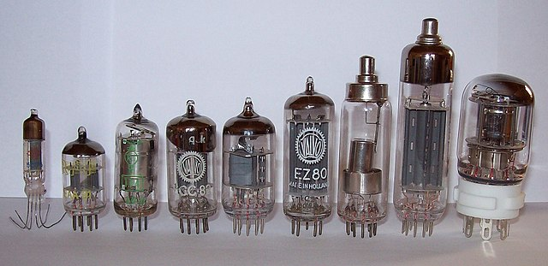
Resistor–transistor logic (RTL)
Resistor–transistor logic (RTL) is a class of digital circuits built using resistors as the input network and bipolar junction transistors (BJTs) as switching devices. Several early transistorized computers (e.g., IBM 1620, 1959) used RTL, where it was implemented using discrete components.
Above picture represents RTL logic NOR gate. According to the principles of BJT, if we give high voltage (or “1”) to the any of input terminals (A,B,C), transistor will be activated and that is why voltage will go to the ground eventually output (Q) will be low (or “0”). If all input terminals are “0”, output will be “1”. So the truth table of NOR gate is proved.
Above picture represents the vacuum tubes which is used to make RTL and DRL logic computers.

Slide 3
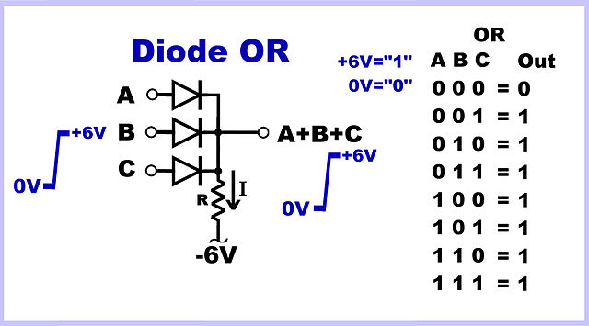
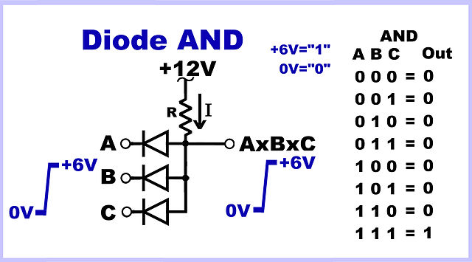
Diode–resistor logic (DRL)
Diode-resistor logic (DRL), is the construction of Boolean logic gates from diodes. Diode logic was used extensively in the construction of early computers, where semiconductor diodes could replace bulky and costly active vacuum tube elements.
Above picture represents DRL logic OR gate. According to the principles of diode, if we give high voltage (or “1”) to the any of input terminals (A,B,C), diode will be short and that is why voltage will go to the output eventually output will be high (or “1”). If all input terminals are “0”, diode will be open and output will be “1”. So the truth table of OR gate is proved. Analogically, we can easily prove the truth table for AND gate.

Slide 4
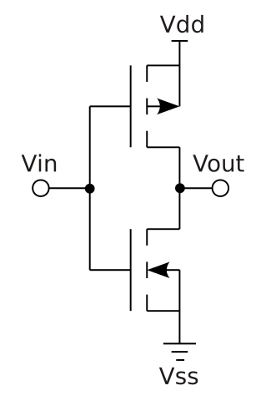
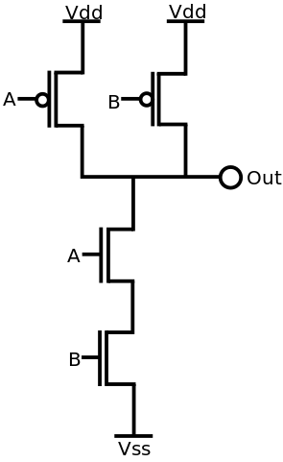
Complementary MOS (CMOS) logic
Complementary metal–oxide–semiconductor (CMOS) is a type of MOSFET fabrication process that uses complementary and symmetrical pairs of p-type and n-type MOSFETs for logic functions. CMOS technology is used for constructing ICs, chips, including microprocessors, microcontrollers, memory chips (including CMOS BIOS), and other digital logic circuits.
Right picture represents CMOS logic NOT gate. According to the principles of MOSFET, if we give high voltage (or “1”) to the input terminal (Vin), p-channel MOSFET will be OFF and n-channel MOSFET will be ON that is why voltage will go to the ground eventually output will be low (or “0”). If input terminal are “0”, p-channel MOSFET will be ON and n-channel MOSFET will be OFF and output will be “1”. So the truth table of NOT gate is proved. Analogically, we can easily prove the truth table for NAND gate.
Inverter
NAND

Slide 5
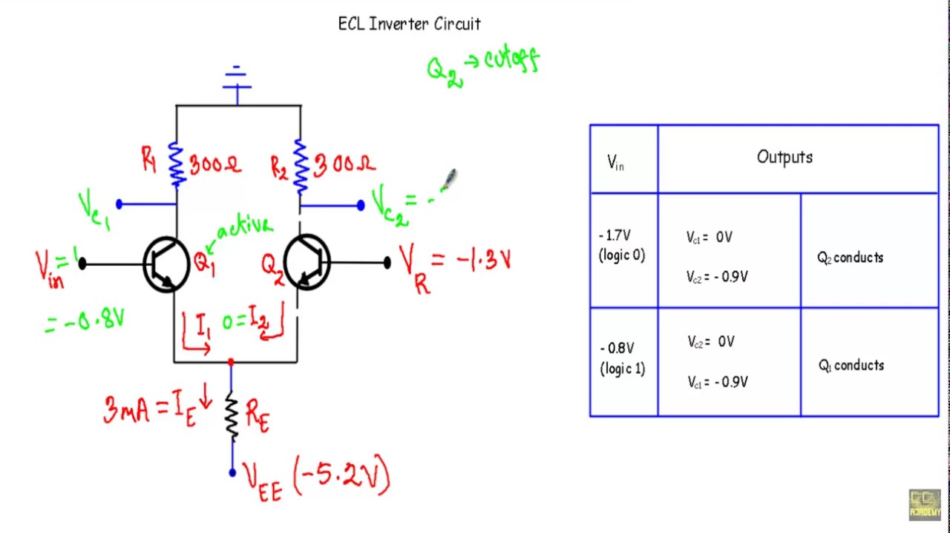
Emitter-coupled logic (ECL)
Emitter-coupled logic (ECL) is a high-speed integrated circuit bipolar transistor logic family. ECL uses an overdriven BJT differential amplifier with single-ended input and limited emitter current to avoid the saturated (fully on) region of operation and its slow turn-off behavior.

Slide 6
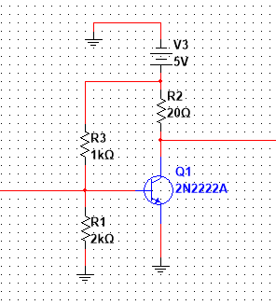
Transistor–transistor logic (TTL)
Transistor–transistor logic (TTL) is a logic family built from bipolar junction transistors. Its name signifies that transistors perform both the logic function (the first "transistor") and the amplifying function (the second "transistor").
Right picture shows the TTL NOT gate design. BJT transistor is biased using R1 and R3 resistors. R2 is used to avoid short circuit. When we give high to the input, we will get low in the output and vice verse. Eventually, we proved the truth table for the inverter.
output
input
TTL Inverter

